Slide 1
VSM-Fiori Access: Complete Vendor Onboarding Walkthrough​
A Step-by-Step Onboarding Guide for Vendors​
Last updated: February 03, 2026

Slide 2
Welcome & Webinar Objectives​
Welcome to the DLA VSM-Fiori Onboarding Webinar.​
Objective: To provide a complete, step-by-step walkthrough for vendors to gain access to the VSM-Fiori platform.​
Agenda:​
Part 1: Creating Your AMPS Account​
Part 2: The First-Time Login (AMPS, OKTA, Fiori)​
Part 3: Routine Logins​
Part 4: Troubleshooting​
Live Q&A Sessions throughout.​
Note: A comprehensive VSM Fiori User Guide can be requested by emailing ‘delivery@dla.mil’.

Slide 3
Part 1: Creating Your Foundation - AMPS​
Important: When requesting roles in AMPS it is important to know the difference between your cage and DODAAC​
CAGE= 5 letters​; alpha characters must be typed in all CAPS.
DODAAC= 6 letters​
Make sure when applying for roles in AMPS you are using your cage and not your DODAAC​

Slide 4
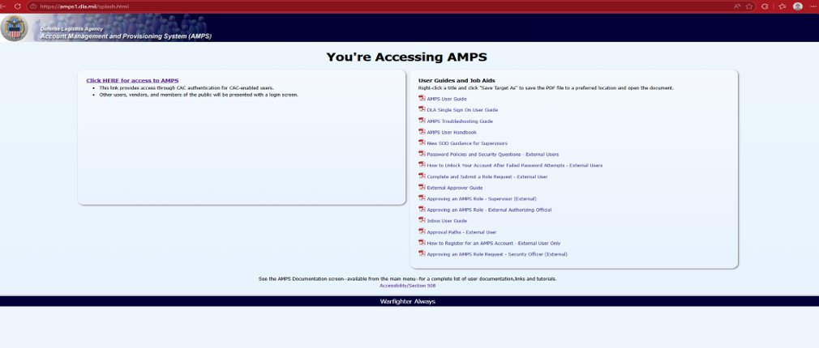
Part 1: Creating Your Foundation - AMPS​
AMPS.DLA.MIL​
The Account Management and Provisioning System (AMPS) is your first step.​
Without an AMPS account, you cannot access DLA applications.​
This creates your basic identity within the DLA network.​

Slide 5
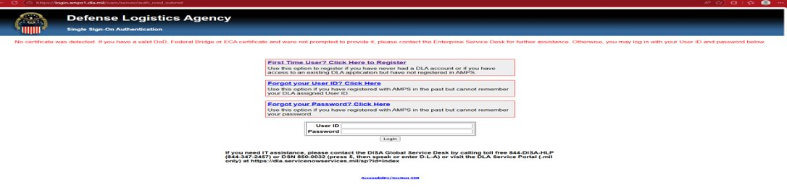
Step 1 & 2: Registration and Profile​
Begin Registration:​
  Navigate to: https://prov.amps1.dla.mil/identity/​
  Select "First Time User? Click Here to Register."​
  Enter email and click Submit.​
Create Profile:​
  Click the link in the confirmation email.​
  User Type: "I am a Supplier or Vendor to DLA".​
  Include your primary CAGE code.​

Slide 6
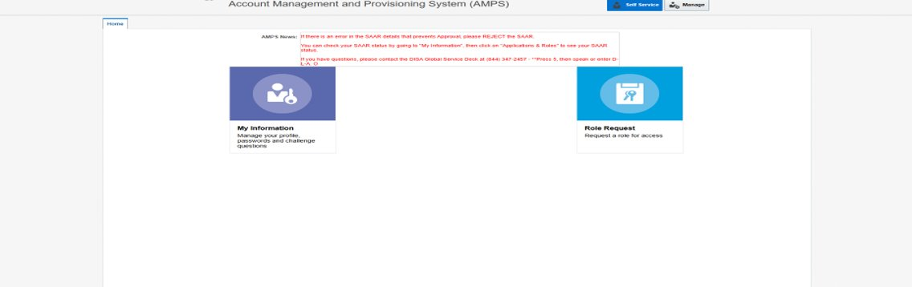
Step 3: Request Required Roles​
Return to the AMPS homepage and select "Request Role".​
Base Role: EBS Prod External – EBS Portal VSM FIORI JD-00862(YOU MUST HAVE THIS ROLE AND CHOOSE ONE ROLE BELOW)​
VSM Role (Choose one): (MUST CHOOSE ONE ROLE BELOW)​
  Regular: VSM Prod - Vendor Shipment Module (VSM) User – Regular WMSV-027​
  Elevated: VSM Prod - Vendor Shipment Module (VSM) User – Elevated WMSV-028​
  (Elevated allows retiring POs, setting facility hours, requesting new locations).​

Slide 7
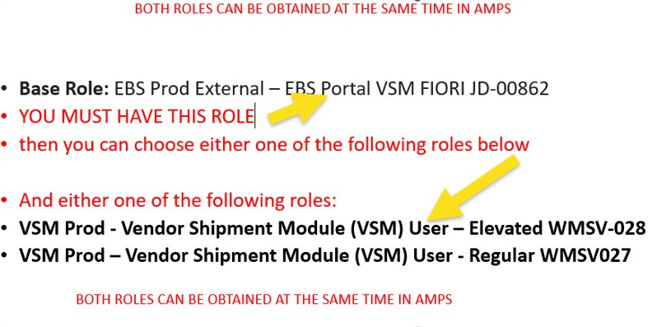
AMPS WMS Role Request

Slide 8
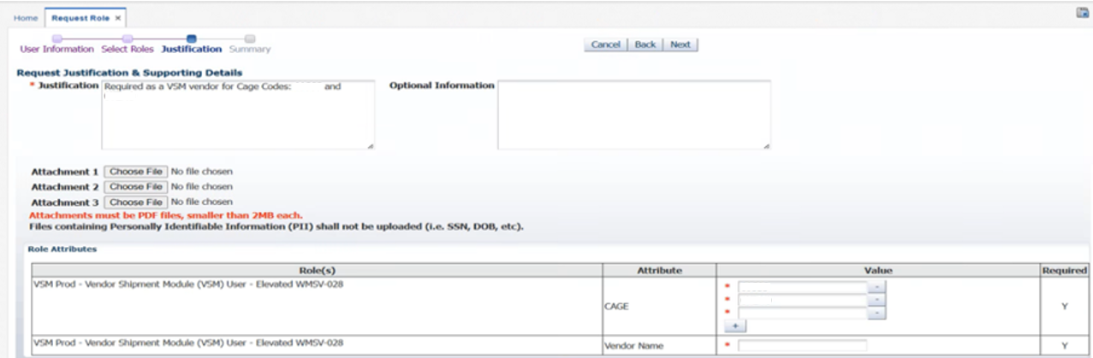
Step 4 & 5: Multiple CAGEs & Approval​
Adding CAGE Codes:​
  Use the "+" icon in the Role Attributes section during registration.​
  Existing users: My Information -> Applications & Roles -> Additional Role Attributes.​
Await Approval:​
  Takes up to 2 business days.​
  You will receive an email with your VSM-Fiori User ID and temporary password.​
  Check your Spam/Junk folder!​

Slide 9
Q&A
Let's pause.​
Are there any questions about the AMPS registration process?​
Do you have questions about CAGE codes or role selection?​
Please type your questions in the chat.​

Slide 10
Part 2: The First-Time Login​
This is a critical, one-time setup process.​
It links your AMPS identity, your OKTA authenticator, and the Fiori system.​
We will cover two paths:​
  Path A: With a mobile device (Smartphones).​
  Path B: Without a mobile device (Windows PC).​
​
On your mobile device, download the Okta Verify app from the Apple (iPhone) or​ Google Play stores. (Android devices)​

Slide 11
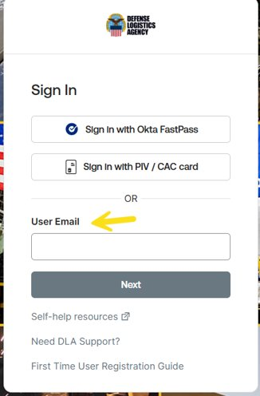
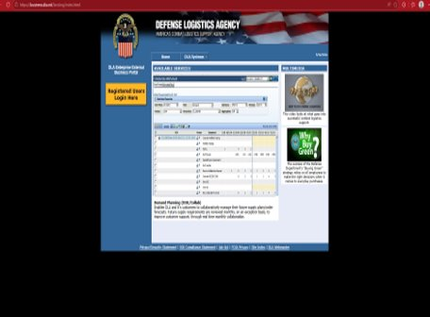
Path A: Mobile Device Setup (Steps 1 & 2)​
Step 2A (Initial Login):​
Go to https://business.dla.mil.​
CRUCIAL: Enter your AMPS email address and AMPS password.​
Do NOT use the temporary Fiori password yet.​

Slide 12
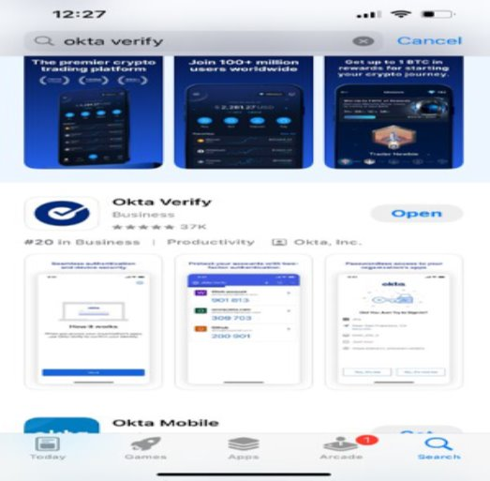
Path A: Mobile Device Setup (Steps 1 & 2)​
Step 1A: Download the "Okta Verify" app from the Apple App Store or Google Play Store.​

Slide 13
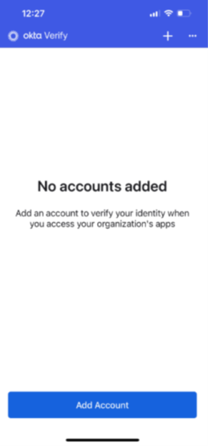
Path A: Mobile Device Setup (Steps 1 & 2)​
Open the Okta Verify app and follow the instructions to ‘Add Account’​

Slide 14
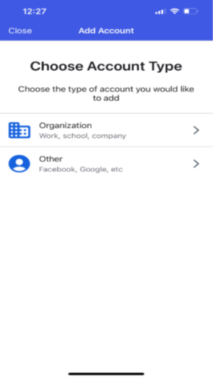
Path A: Mobile Device Setup (Steps 1 & 2)​
Choose to add a ‘Organization’ type account​

Slide 15
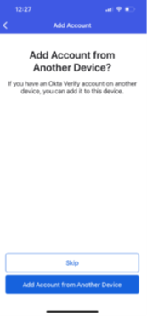
Path A: Mobile Device Setup (Steps 1 & 2)​
Choose ‘Skip’​

Slide 16
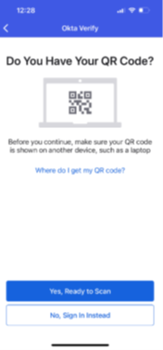
Path A: Mobile Device Setup (Steps 1 & 2)​
We will come back to this screen ​

Slide 17
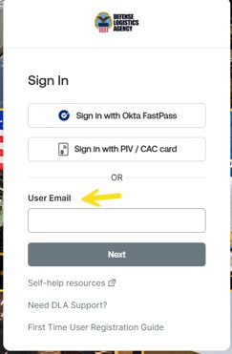
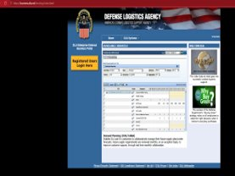
Path A: Mobile Device Setup (Steps 1 & 2)​
Step 2A (Initial Login):​
  Go to https://business.dla.mil. Click on yellow tab on left​
  CRUCIAL: Enter your AMPS email/ click next ​
  Do NOT use the temporary Fiori password yet.​

Slide 18
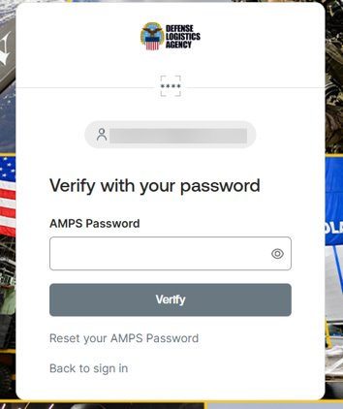
Path A: Mobile Device Setup (Steps 1 & 2)​
Enter you AMPS password here/ click verify​
​
Do NOT use the temporary Fiori password yet.​

Slide 19
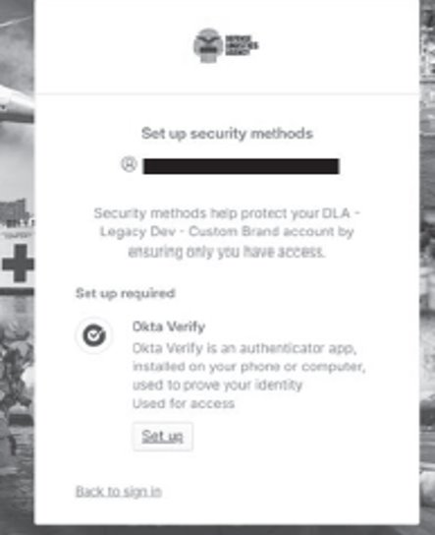
Path A: Mobile Device Setup (Steps 3 & 4)​
Step 3A (Configure MFA):​
An OKTA setup window appears. Click ‘Set up’.​

Slide 20
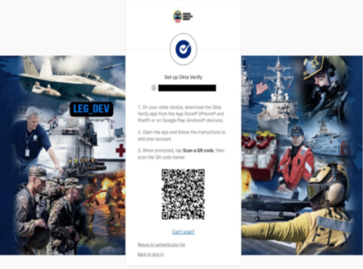
Path A: Mobile Device Setup (Steps 3 & 4)​
A QR code will display on your screen​
Step 4A (Link Account):​
  Open Okta Verify on your phone.​
  Tap ‘Add Account’ -> ‘Organization’ -> ‘Scan a QR code’.​
  Scan the code on your screen.​

Slide 21
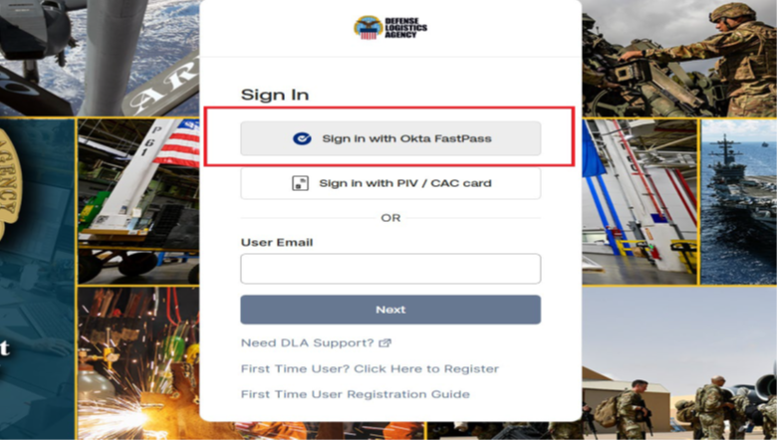
Path B: Windows Setup (Steps 1 & 2)​
Step 1B: Go to https://business.dla.mil ‘Sign In with Okta FastPass’.​
Step 2B: If needed, click ‘Download here’ to install Windows Okta Verify. Run the installer.​

Slide 22
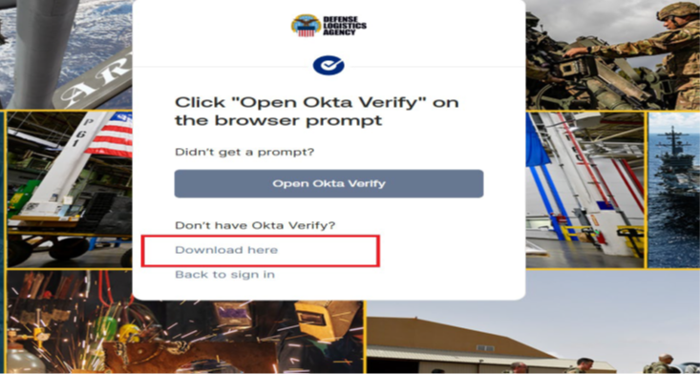
Path B: Windows Setup (Steps 1 & 2)​
In most cases the user won’t have Okta Verify installed so they will need to click the​
‘Download here’ link​

Slide 23
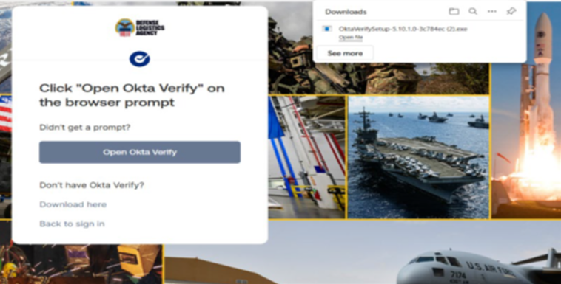
Path B: Windows Setup (Steps 1 & 2)​
The screenshot shows the PC downloading the Okta Verify exe file.
Once download is complete. Click ‘Open file’ to run the exe and complete the install​

Slide 24
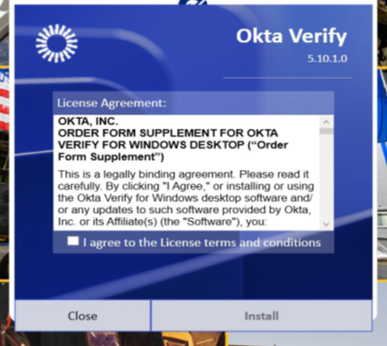
Path B: Windows Setup (Steps 1 & 2)​
Click ‘Install​’

Slide 25
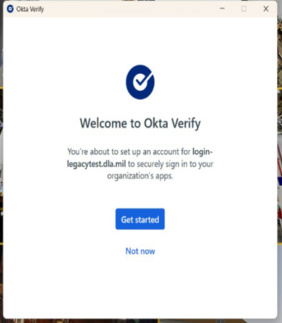
Path B: Windows Setup (Steps 1 & 2)​
Click ‘Get started’

Slide 26
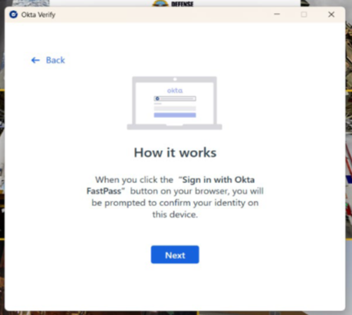
Path B: Windows Setup (Steps 1 & 2)​
After clicking ‘Next’ the user will be directed to the DLA okta login page ​

Slide 27
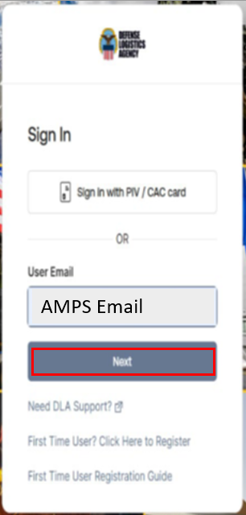
Path B: Windows Setup (Steps 1 & 2)​
Enter the ‘email’ in the User Email field ​
Enter your AMPS email/ click ‘Next​’

Slide 28
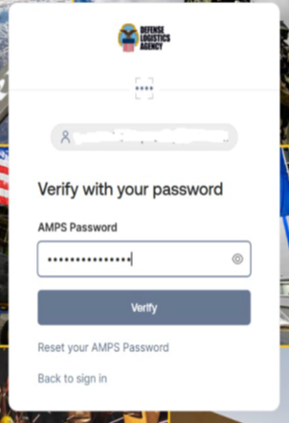
Path B: Windows Setup (Steps 1 & 2)​
The user enters their AMPS password ​

Slide 29
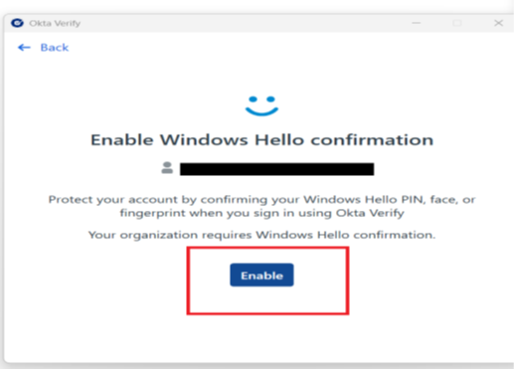
Path B: Windows Setup (Steps 1 & 2)​
After entering the password the user will be redirected back to Okta Verify application.
Click the ‘Enable button ​

Slide 30
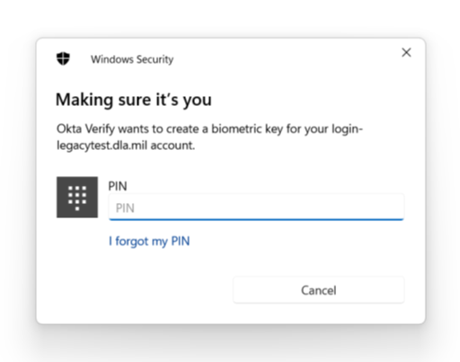
Path B: Windows Setup (Steps 1 & 2)​
The user will be prompted by Windows Security to enter the PC’s login PIN ​

Slide 31
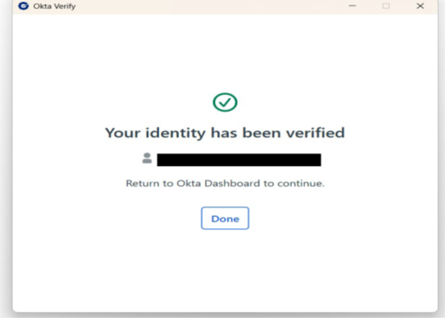
Path B: Windows Setup (Steps 1 & 2)​
Okta will confirm the login is verified, select ‘Done’

Slide 32
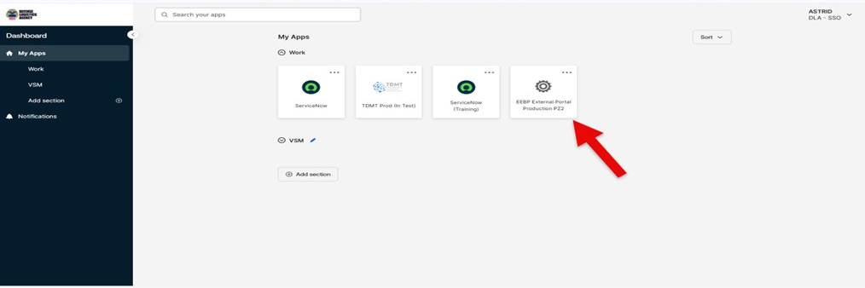
Path B: Windows Setup (Steps 1 & 2)​
On successful login the user is presented their Okta Dashboard showing the application tiles the user has access too. Some will see this screen some will not. If this screen comes up select the ‘EEBP External Portal​’ tile

Slide 33
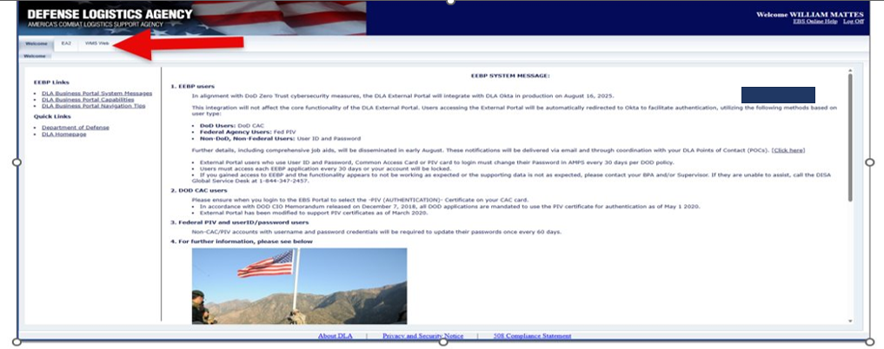
WMS HOME PAGE​
WMS HOME SCREEN TAB TOP LEFT CORNER

Slide 34
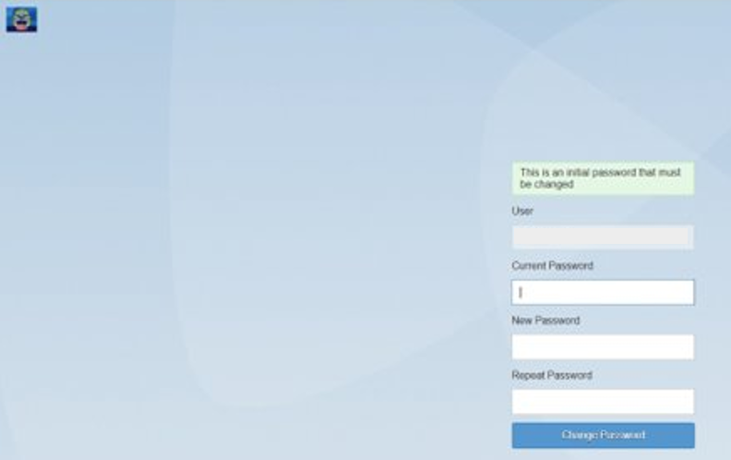
Step 5: Final Fiori Authentication (ALL USERS)​
You will be redirected to the FIORI login screen.​
NOW use the credentials from your approval email:​
  Enter the VSM-Fiori User ID / AMPS USER ID.​
  Enter the Temporary Fiori Password.​
Create a new, permanent password (16+ characters, standard complexity).​
Select ‘Change Password’
You are now logged into WMS!​
You will never need the temporary Fiori credentials again.​

Slide 35
ROOT CERTIFICATES​
Please try the below if you are receiving security warnings or not secure warnings.​
Navigate to the official DoD Cyber Exchange site:
  https://www.cyber.mil/pki-pke/end-users/getting-started/ ​
Download the most recent version of the InstallRoot NIPR Windows Installer. ​
Run the installer and proceed through the setup using the default prompts. ​
Additional certificate guidance and troubleshooting is available at https://militarycac.com ​

Slide 36
CANNOT REACH THIS PAGE Error​
Please try the below:
​
1. Open Notepad and select run as admin​
2. Go to File explore and navigate to C:\Windows\System32\drivers\etc\hosts (change file type filter to all files)​
3. At the bottom of the file, add:​
4. Save the file. Open command prompt and run: ipconfig/flushdns​

Slide 37
LABELS NOT DISPLAYING​
The browser pop-up blocker is preventing the additional forms from displaying. You’ll need to add https://wms.dla.mil to the approved list.​

Slide 38
Q&A
Let's pause.​
Are there any questions about the AMPS registration process?​
Do you have questions about CAGE codes or role selection?​
Please type your questions in the chat.​

Slide 39
Part 3: Subsequent Logins - Routine Access​
If using the Mobile App:​
  Go to https://business.dla.mil.​
  Enter AMPS email and password.​
  Open Okta Verify on phone, enter the 6-digit code.​
  Click the "WMS" tab in the top left corner.​
If using Windows FastPass:​
  Go to https://business.dla.mil, click "Sign In with Okta FastPass".​
  Enter Windows PIN/Biometrics.​
  Click the "WMS" tab in the top left corner.​

Slide 40
Part 4: Troubleshooting Common Errors​
Certificate Errors (NET:ERR_CERT...):​
Install DoD root certificates from cyber.mil.​
Forgotten Passwords:​
AMPS: Use the "Forgot Password" link on the AMPS Gateway.​
Fiori: If locked out, wait 30 minutes to expire, then try the permanent password again.​
Expired Temp Password:​
You must login within 5 days of approval, or it expires.​

Slide 41
Final Q&A & Resources v2​
A comprehensive VSM Fiori User Guide can be requested by emailing ‘delivery@dla.mil’.

